Slide 1
CS 4530: Fundamentals of Software Engineering Module 3.1: Trusting TypeScript (or not!)
Adeel Bhutta and Mitch Wand
Khoury College of Computer Sciences
© 2026 Released under the CC BY-SA license

Slide 2
When Have I Written Enough Tests?
Notes:
The key question of this lecture is: when have I written enough tests?
We’re going to answer this question in three different ways

Slide 3
When Have I Written Enough Tests?
When I’ve tested the valid inputs
When I’ve tested all the code
When the tests will catch bugs
Notes:
The first answer we give, when I’ve described all the valid inputs, motivates some more discussion of TypeScript.
The second answer is based on code coverage, a very common metric of test adequacy in modern software engineering.
The third answer is probably the most compelling: we’ve written enough tests when the tests will catch bugs!

Slide 4
Learning Goals for this Lesson
At the end of this lesson, you should be able to
Explain how TypeScript types and documented preconditions influence what tests you need to write
Explain the difference between the any vs unknown types in TypeScript
Understand the structure of a simple Express server incorporating Zod validation
Notes:
Let’s start by discussing how TypeScript lets you document what inputs a function or program can have.

Slide 5
What Inputs Should We Test?
/** Returns an array that repeats "hello"
* @param numHellos - number of “hello”s to return, must be an integer >= 0
*/
function helloNTimes(numHellos: number): string[] { const arr: string[] = [];
for (let i = numHellos; i !== 0; i--) { arr.push("hello"); } return arr;
}
What input values do I need to test this function on?
Edge cases (definitely 0)
Probably 1 and some larger number? But most numbers > 1 are kind of interchangeable => “equivalence classes”
What about -3? 1.4? NaN? null? { lol: 'owned' } ?
Notes:
Mention: “kind of interchangeable” has a formal name, “equivalence classes of inputs.”
There are two types of contracts in this function: the TypeScript one says that the input must be a number, and the one document in the precondition that says that it must be a nonnegative integer.

Slide 6
For Unit Testing, Tests Inputs Should Respect a Function’s Contracts
Unit Tests: testing a single function in isolation
Unit testing only needs to give a function tests that respect the functions preconditions: no need to test -3 or 1.4
Integration Tests test how parts of a program work together: that’s where we ensure other functions respect our function’s contracts.
/** Returns an array that repeats "hello"
* @param numHellos - number of “hello”s to return, must be an integer >= 0
*/
function helloNTimes(numHellos: number): string[] { const arr: string[] = [];
for (let i = numHellos; i !== 0; i--) { arr.push("hello"); } return arr;
}
Notes:
This is something we’ll return to later, but the answer to “which inputs should we test” is that we don’t need to test this function with -3 or null.
When we’re talking about testing a specific function, we’re really talking about writing a unit test, that tests an isolated part of a program. Other parts of the program are responsible for respecting the contracts on our function, but that’s a problem for integration testing, which we’ll talk about more in a future lecture.
It’s valid to say “we never need to write unit test inputs that violate preconditions,” and it is also valid to look at this and say “we can’t possibly trust ourselves and the evolution of our code over time — test calling the function on an invalid message ID, or passing null as the chat ID, anyway!” There’s not a single right answer.
What are the drawbacks for writing tests that violate the function’s stated preconditions? (One answer: if you write tests that violate the preconditions, that may push you to check for the precondition violation in code. Which means your code is now more slower and more complicated than it had to be!)

Slide 7
What Trusting Contracts Looks Like
/**
* Adds a message to a chat, updating the chat
*
* @param chatId - Ostensible chat id
* @param user - Authenticated user
* @param messageId - Valid message id
* @returns the updated chat info object
* @throws if the chat id is not valid
*/
export function addMessageToChat(
chatId: string,
user: UserWithId,
messageId: string
): ChatInfo {
Requires a chatId, which may or may not be valid. Check for this!
Requires a Valid messageId => no need to check for this!
Notes:
A digression: here’s a more “real” version of our example, a piece of code from the project codebase. Both the comments and the types are telling us about the function’s preconditions, which help set the expectations for testing the code.
The written contracts in this function’s docstring are saying that the chatId input is something that claims to be a chatId, but it might not actually represent a real chat ID. The docstring for the `messageId` argument is saying that the messageId must be a valid id that corresponds to a message in the database.
If we’re writing unit tests based on this documentation, it means we’d definitely want to test this function with a valid chat ID and an invalid chat ID. But we’re requiring that the message ID is valid as a precondition of the function, so if we’re trusting that this function will be called in ways that respect the function’s contracts, we don’t need to test it with a random string message ID that can’t possibly correspond to a message.

Slide 8
TypeScript Types Help With (Some) Contracts
TypeScript is helpful, but it’s obviously only providing help in making sure that the function gets 3 and not “three”. It’s not going to help with 3 versus 3.1 or -8 or NaN.
/** Returns an array that repeats "hello"
* @param numHellos - number of “hello”s to return, must be an integer >= 0
*/
function helloNTimes(numHellos: number): string[] { const arr: string[] = [];
for (let i = numHellos; i !== 0; i--) { arr.push("hello"); } return arr;
}
Notes:
Having contracts checked by code is, generally, good! TypeScript helps us check some of our contracts, but obviously we may have preconditions that aren’t expressible in TypeScript.
There’s an important caveat, however!

Slide 9
TypeScript Types Are Easily Circumvented (1)
In a language like Java, we’d need to worry that another function could call helloNTimes with -3: calling the function with a string or null is a compiler error.
That’s not true in TypeScript, and that can be surprising.
/** Returns an array that repeats "hello"
* @param numHellos - number of “hello”s to return, must be an integer >= 0
*/
function helloNTimes(numHellos: number): string[] { const arr: string[] = [];
for (let i = numHellos; i !== 0; i--) { arr.push("hello"); } return arr;
}
Notes:
This is a critical point about TypeScript, and one that can be really surprising at first.
In Java, we’d need to be concerned that some malicious function would call an analogue of “helloNTimes” with a negative number, but there’d be no way to call it with a value of some completely unexpected type: Java would never allow such a thing to happen.
That’s not true about TypeScript

Slide 10
TypeScript Types Are Easily Circumvented (2)
In a language like Java, we’d need to worry that another function could call helloNTimes with -3: calling the function with a string or null is a compiler error.
That’s not true in TypeScript, and that can be surprising.
TypeScript will happily accept the following as a well-typed expression:
helloNTimes({ lol: 'owned ' } as unknown as number)
They do seem to make it less likely you’ll screw up accidentally…, and ESLint + TypeScript work together to do even more
Notes:
Unlike some languages, the type contracts in TypeScript are totally unchecked — Node will happily run the function with an argument that is not a JavaScript number at all, just as it will happily run it on an input that violates the “nonnegative integer” contract in the precondition. Node will run code even if TypeScript says it’s bad!
But it’s even worse: no matter how picky you make TypeScript, it can be pretty easily convinced to ignore obvious type errors, such as this one. This is fundamental to TypeScript, but can be very confusing if you’re used to types in languages that aren’t Python and JavaScript.
So why are we using TypeScript at all? Well, a lot of people obviously find a lot of value in using TypeScript, and we’re using it in this course for a reason. The reality is that different software projects use TypeScript in fundamentally different ways. It’s possible, in most cases, to make choices in a project that make mistakes less likely. In general, the more you utilize TypeScript type to prevent violating a function’s contracts, the faster you’ll find bugs, and the less you’ll need to rely on your integration tests to find issues.
Our project code sets up the ESLint linter with a lot of rules that enforce this strict use of TypeScript.

Slide 11
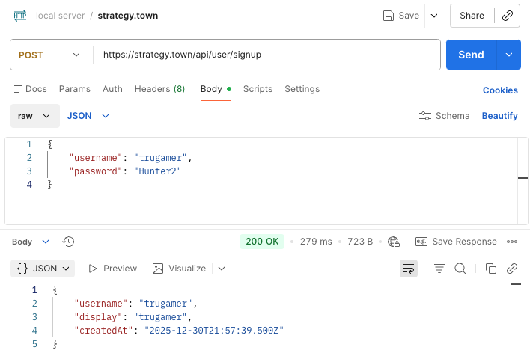
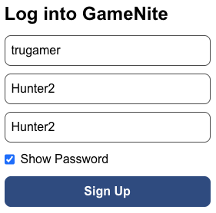
Where Might An Untrusted Input Come From?
Any input given to a web app can also be given by other means…
curl https://strategy.town/api/user/signup -H 'Content-Type: application/json' \
--data '{ "username": "trugamer", "password": "Hunter2" }'
Notes:
Not all inputs to your programs can be trusted to have any particular shape or form!
When you give an input to a website through a web browser, the code on the web browser will make sure the request has a specific format. But the nature of web applications is that those submissions can always be done in different ways, without the same guardrails.
On the upper right we show the same action of creating a GameNite account being done through the “Postman” program (there’s a Postman tutorial on the website), and on the command line with a command-line “curl” command. (You can get “curl” commands out of Postman too.)

Slide 12
Untrusted Inputs Should Have Type unknown
The appropriate TypeScript type for an unknown value is unknown
function lookAtMe(input: unknown) {
console.log(input.toUpperCase());
if (typeof input === "string") {
console.log(input.toUpperCase());
}
}
If you use the any type instead, TypeScript will just say “ok, I guess you know what you’re doing”
TypeScript error here!
it’s ok here!
Notes:
TypeScript has a way of dealing with inputs when you can’t trust that the input is going to obey any sort of contract: the unknown type.
(click)
If you have an unknown value and you try to do pretty much anything to it (such as cast it to uppercase like it’s a string), TypeScript will yell at you.
(click)
But if you check that it’s a string first with JavaScript’s typeof function, TypeScript will then remember that you’ve checked that it’s a string.

Slide 13
How Can unknown Inputs Be Used Safely?
This can get complicated fast…
export type Auth = { username: string, password: string }
function useAuth(x: unknown) {
if (
(typeof x === 'object' && x !== null) &&
('username' in x && typeof x.username === 'string’) &&
('password' in x && typeof x.password === 'string’)
) {
const auth: Auth = { username: x.username, password: x.password };
// write the code you care about here!
}
}
Notes:
This was just about shortest code I could come up with to use straightforwardly use TypeScript to reliably take an unknown piece of data and get record with a string username and a string password. It’s not simple!
TypeScript makes us do all the work ourselves if we want to check that a value actually matches the structure that its type suggests. This is difficult and error-prone in practice.

Slide 14

Libraries Make Checking Types Easier
Zod is a library that makes checking structure less tedious & error-prone.
import { z } from 'zod’;
const zAuth = z.object({ username: z.string(), password: z.string() });
export type Auth = z.infer<typeof zAuth>;
function useAuth(x: unknown) {
const parseResult = zAuth.safeParse(x); if (parseResult.success) {
const auth: Auth = parseResult.data;
// write the code you care about here!
}
}
Notes:
Zod is a library that makes our job easier — we can create Zod representations of the TypeScript types, and then use a function like safeParse to ensure that the object really has the structure we expect it to have.
(click)
If you put this code in VSCode and hover over “Auth”, you’ll see it’s exactly the type that we want, so we don’t even have to write the same type twice.

Slide 15
Some Libraries Use any: Common But Dangerous
import express from 'express';
const app = express();
app.use(express.json());
type Auth = { username: string; password: string };
app.post('/', (req, res) => {
const auth: Auth = req.body;
if (auth.password !== 'secret') {
res.status(403).send({ error: 'Wrong password' });
} else {
res.send({ message: `WELCOME,${auth.username.toUpperCase()}` });
}
});
app.listen(8000, () => console.log(`Listening on port 8000`));
This has type “any” 😭
Notes:
Here’s a small webserver that uses Express, the same library that the course project uses.
The third line where we “use” express.json() covers an enormous amount of validation — it ensures that our web server will only respond to specific requests that send JSON data (we’ll be using JSON data a lot in the class, there’s an article about it in the resources for this lecture)
(click)
However, the line that lets `req.body` be treated as an `Auth` (where the second arrow is pointing) has some really unfortunate typescript happening. If you read this line, it looks like you’re now able to trust that the request body matches the `Auth` type. But this is not true. This line only works in Typescript because the express library treats untrusted request bodies as “any”, not as “unknown.” This makes the express server a lot easier to use… and also makes it a lot easier to make errors. It’s would have been better design for express to treat req.body as 'unknown’.
(History: the unknown type was only added to TypeScript in 2018, and the TypeScript spec for express dates back to at least 2012 — https://github.com/DefinitelyTyped/DefinitelyTyped/commit/a6f2316773e0456d947381afb7683a7ac6548e24 , specifically. So express uses the any type as another artifact of maintaining software over time.)
Given how complicated we just saw it was to make sure that an unknown input had the correct format, this decision mostly makes sense.
(Optional Q: what input would cause an exception that typescript would seem to make impossible? See next hidden slide)

Slide 16
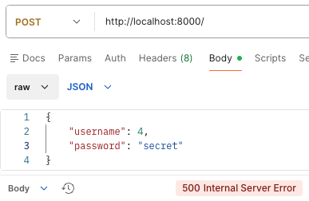
Some Libraries Use any: Common But Dangerous
import express from 'express';
const app = express();
app.use(express.json());
type Auth = { username: string; password: string };
app.post('/', (req, res) => {
const auth: Auth = req.body;
if (auth.password !== 'secret') {
res.status(403).send({ error: 'Wrong password' });
} else {
res.send({ message: `WELCOME,${auth.username.toUpperCase()}` });
}
});
app.listen(8000, () => console.log(`Listening on port 8000`));
Notes:
Plausible but incorrect answer: null or 3, anything that will cause an error if you try to project out the “password” field. This actually doesn’t work, because express.json() only accepts JSON that represents an object or an array.
You can allow any JSON by replacing express.json() with express.json({ strict: false })
True answer: something like { username: 4, password: “secret” } will try to invoke the toUpperCase method of the numeric value 4, but JavaScript numbers don’t have toUpperCase methods — only strings do!

Slide 17
Improving This Web Server With Zod
import { z } from 'zod';
import express from 'express';
const app = express();
app.use(express.json());
const zAuth = z.object({ username: z.string(); password: z.string() });
app.post('/', (req, res) => {
const auth = zAuth.safeParse(req.body);
if (auth.error) {
res.status(400).send({ error: 'Unexpected message' }); } else if (auth.data.password !== 'secret') {
res.status(403).send({ error: 'Wrong password' });
} else {
res.send({ message: `WELCOME,${auth.data.username.toUpperCase()}` });
}
});
app.listen(8000, () => console.log(`Listening on port 8000`));
Notes:
Express’s design was set in stone before tools like Zod existed that made it easier to build code that actually gets validation right.

Slide 18
Zod Can Check Conditions Even Finer than TypeScript Types
const zHelloInput = z.int().gte(0);
/** Returns an array that repeats "hello"
* @param numHellos - number of times to say “hello”
* @throws if the input is not an integer >= 0
*/
function helloNTimes(numHellos: unknown): string[] { const parseResult = zHelloInput.safeParse(numHellos);
if (!parseResult.success) throw new Error("Invalid input");
const arr: string[] = [];
for (let i = parseResult.data; i !== 0; i--) { arr.push("hello"); } return arr;
}
Notes:
Coming back around to the initial example, if we had to write helloNTimes to take untrusted inputs with the unknown type, we could use Zod to check that the input is not only a JavaScript number, but that it’s an integer greater than are equal to zero. This changes the function’s contract: both the TypeScript and the JavaDoc allow weird inputs to the function, with the specification that this will cause the function to throw an error.

Slide 19
Review
One view of TypeScript is that it’s a handy way of documenting, and imperfectly checking, the contracts (preconditions and postconditions) of your code
Do you need to test inputs that violate your contracts? It depends!
You can never trust that the input to a web server will obey any sort of contract — important to test!
Notes:
There’s not a good answer to whether you need to test inputs that violate your contracts!
But you can’t trust anything that you’re receiving from the user over a network connection, even if the webpage prevents certain user actions. Many, many security vulnerabilities are just people getting this wrong.

